Slide 1


<Omar Adly AbdElHalim>
<25/11/2023>

Slide 2

Outline
Executive Summary
Introduction
Methodology
Results
Conclusion
Appendix

Slide 3
Executive Summary
Data Collection: Mined data from SpaceX API and Wikipedia, creating a 'class' column for landing success classification.
Exploration Techniques: Utilized SQL, visualizations, Folium maps, and dashboards for in-depth data exploration.
Feature Preparation: Identified and gathered relevant columns, converting categorical variables to binary through one-hot encoding.
Data Standardization: Ensured dataset uniformity by standardizing, optimizing for machine learning readiness.
Model Development: Employed Logistic Regression, Support Vector Machine, Decision Tree Classifier, and K Nearest Neighbors, yielding consistent 83.33% accuracy.
Future Considerations: Noted a tendency of over-predicting successful landings, emphasizing the need for expanded data for refined model accuracy.

Slide 4
Introduction
Commercial Space Dynamics: The era of Commercial Space has dawned, marked by SpaceX's pioneering role and competitive pricing (e.g., $62 million vs. $165 million USD).
Key to Affordability: SpaceX's cost advantage is anchored in its groundbreaking rocket recovery capability, specifically recuperating Stage 1 components.
The New Contender - Space Y: Positioned to rival SpaceX, Space Y enters the stage, motivated to match or exceed SpaceX's success in rocket recovery.
The Challenge at Hand: Space Y has entrusted us with a pivotal task – the development of a machine learning model geared towards predicting the success of Stage 1 recovery, reflecting the critical role of advanced analytics in shaping the future of space exploration.

Slide 5

Section 1

Slide 6
Methodology
Executive Summary
Data collection methodology:
Integrated datasets sourced from SpaceX's public API and information available on SpaceX's Wikipedia page.
Perform data wrangling
Categorizing landings as successful if true, and unsuccessful otherwise.
Perform exploratory data analysis (EDA) using visualization and SQL
Perform interactive visual analytics using Folium and Plotly Dash
Perform predictive analysis using classification models
How to build, tune, evaluate classification models

Slide 7
Data Collection
The data collection process involved a hybrid approach, combining API requests from the SpaceX public API with web scraping data from a table in SpaceX's Wikipedia entry. The upcoming slide will illustrate the flowchart of data collection from the API, followed by another slide depicting the flowchart of data collection from web scraping. The SpaceX API data comprises columns such as FlightNumber, Date, BoosterVersion, PayloadMass, Orbit, LaunchSite, Outcome, Flights, GridFins, Reused, Legs, LandingPad, Block, ReusedCount, Serial, Longitude, and Latitude. On the other hand, the Wikipedia web scrape data includes columns like Flight No., Launch site, Payload, PayloadMass, Orbit, Customer, Launch outcome, Version Booster, Booster landing, Date, and Time.

Slide 8
Data Collection – SpaceX API
Request (Space X APIs)
Json_normalize to DataFrame data from JSON
Filter data to only include Falcon 9 launches
Dictionary relevant data
Imputate missing
https://github.com/OmarAdlii/Applied-Data-Science-Capstone/blob/main/jupyter-labs-spacex-data-collection-api.ipynb

Slide 9
Data Collection - Scraping
Request Wikipedia html
BeautifulSoup html5lib Parser
Find launch info html table
Cast dictionary to DataFrame
Iterate through table cells to extract data to dictionary
Create dictionary
https://github.com/OmarAdlii/Applied-Data-Science-Capstone/blob/main/jupyter-labs-webscraping.ipynb

Slide 10
Data Wrangling
Generate a training label for landing outcomes, assigning '1' to successful landings and '0' to failures. The 'Outcome' column encompasses two components: 'Mission Outcome' and 'Landing Location.' Introduce a new training label column named 'class,' with a value of '1' if 'Mission Outcome' is True and '0' otherwise. The value mapping is as follows: True ASDS, True RTLS, and True Ocean are set to '1,' while None None, False ASDS, None ASDS, False Ocean, and False RTLS are set to ‘0’.
https://github.com/OmarAdlii/Applied-Data-Science-Capstone/blob/main/jupyter-labs-webscraping.ipynb

Slide 11
EDA with Data Visualization
Conducted Exploratory Data Analysis (EDA) on key variables, including Flight Number, Payload Mass, Launch Site, Orbit, Class, and Year.
Employed a variety of plots, such as Flight Number vs. Payload Mass, Flight Number vs. Launch Site, Payload Mass vs. Launch Site, Orbit vs. Success Rate, Flight Number vs. Orbit, Payload vs Orbit, and Success Yearly Trend.
Utilized scatter plots, line charts, and bar plots to assess relationships between variables, determining their significance for incorporation into the machine learning model training process.
https://github.com/OmarAdlii/Applied-Data-Science-Capstone/blob/main/jupyter-labs-eda-dataviz.ipynb

Slide 12
EDA with SQL
Imported the dataset into an IBM DB2 Database and leveraged SQL-Python integration to execute queries for enhanced data analysis.
Employed SQL queries to extract insights into the dataset, including information about launch site names, mission outcomes, payload sizes of customers, booster versions, and landing outcomes.
This process provided a comprehensive understanding of key aspects of the dataset, aiding in subsequent analysis and decision-making.
https://github.com/OmarAdlii/Applied-Data-Science-Capstone/blob/main/jupyter-labs-eda-sql-coursera_sqllite.ipynb

Slide 13
Build an Interactive Map with Folium
Utilized Folium maps to visually represent key information, marking Launch Sites, successful and unsuccessful landings, and proximity to significant locations such as Railway, Highway, Coast, and City.
This visualization provided valuable insights into the geographical distribution of launch sites, helping to understand the rationale behind their locations
. Additionally, it facilitated the visualization of successful landings in relation to specific geographic features, contributing to a comprehensive spatial analysis.
https://github.com/OmarAdlii/Applied-Data-Science-Capstone/blob/main/lab_jupyter_launch_site_location.ipynb

Slide 14
Build a Dashboard with Plotly Dash
Developed a dynamic dashboard comprising a pie chart and a scatter plot for comprehensive data representation.
The pie chart offers flexibility, allowing users to toggle between showcasing the distribution of successful landings across all launch sites and viewing individual launch site success rates.
Meanwhile, the scatter plot incorporates interactive elements, enabling users to select between displaying data for all sites or an individual site, and adjusting payload mass within the range of 0 to 10000 kg.
The pie chart serves as a visual aid for launch site success rates, while the scatter plot facilitates a nuanced exploration of success variations based on launch sites, payload mass, and booster version categories.
https://github.com/OmarAdlii/Applied-Data-Science-Capstone/blob/main/spacex_dash_app.py

Slide 15
Predictive Analysis (Classification)
Split label column ‘Class’ from dataset
Fit and Transform Features using Standard Scaler
Train_test_split data
Score models on split test set
Use GridSearchCV on LogReg, SVM, Decision Tree, and KNN models
GridSearchCV (cv=10) to find optimal parameters
Confusion Matrix for all models
Barplot to compare scores of models
https://github.com/OmarAdlii/Applied-Data-Science-Capstone/blob/main/SpaceX_Machine_Learning_Prediction_Part_5.jupyterlite.ipynb

Slide 16
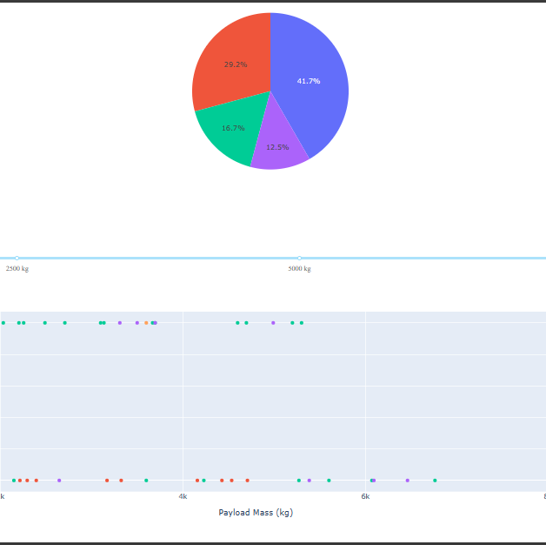
Results
Providing a sneak peek into the upcoming Plotly dashboard, the subsequent sections will present the outcomes of our Exploratory Data Analysis (EDA) employing visualization techniques, EDA using SQL, an Interactive Map featuring Folium, and ultimately, the results of our machine learning model boasting an impressive accuracy rate of approximately 83%.

Slide 17

Section 2

Slide 18
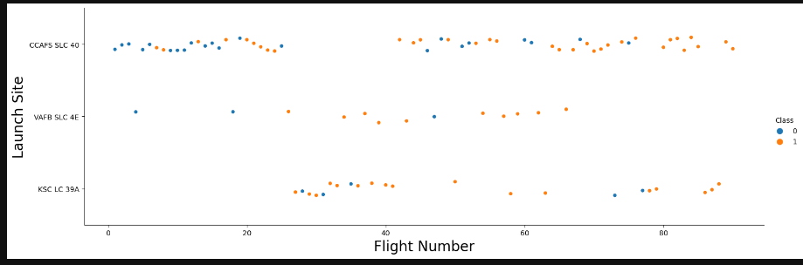
Flight Number vs. Launch Site
Analysis of the graphical representation indicates a noticeable surge in success rates over time, particularly around Flight Number 20, signifying a potential breakthrough. Furthermore, Cape Canaveral Space Force Station (CCAFS) emerges as the primary launch site, characterized by the highest volume of launches.

Slide 19
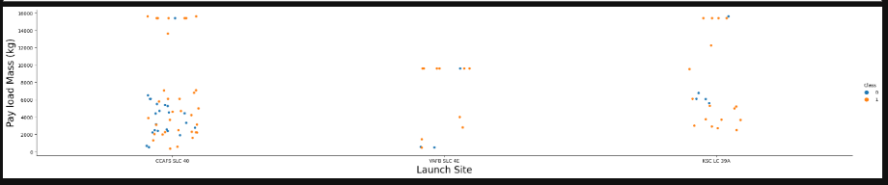
Payload vs. Launch Site
Observations from the data reveal that payload mass is predominantly distributed in the range of 0-6000 kg. Additionally, distinct launch sites exhibit variations in their utilization of payload mass

Slide 20
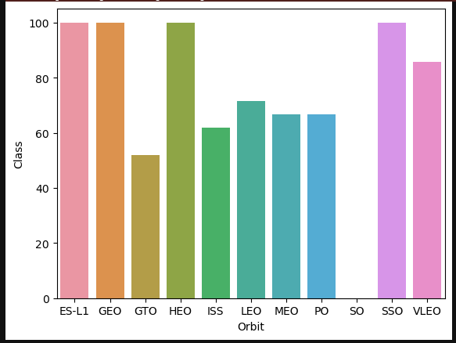
Success Rate vs. Orbit Type
Notable success rates are observed in specific payload orbit types. For instance, missions designated as ES-L1, GEO, and HEO, each with a sample size of 1, exhibit a perfect 100% success rate. Similarly, SSO (5 missions) boasts a 100% success rate. VLEO, with 14 attempts, maintains a decent success rate, while missions in SO (1) register a 0% success rate. GTO, with the largest sample size of 27, achieves an approximately 50% success rate.

Slide 21
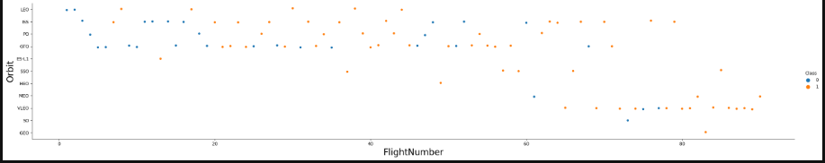
Flight Number vs. Orbit Type
The launch orbit preferences of SpaceX have evolved over Flight Number, showcasing a correlation with launch outcomes. SpaceX initially favored Low Earth Orbit (LEO), achieving moderate success. Subsequently, the company transitioned to Very Low Earth Orbit (VLEO) in recent launches. Notably, SpaceX demonstrates higher success rates in lower orbits, particularly Sun-synchronous orbits.

Slide 22
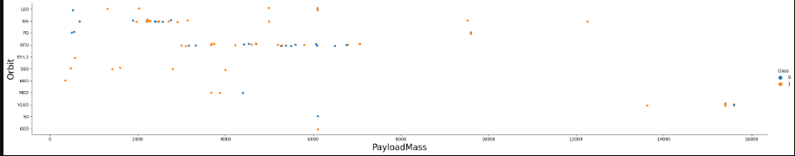
Payload vs. Orbit Type
There is a correlation between payload mass and orbit selection. Low Earth Orbit (LEO) and Sun-synchronous Orbit (SSO) tend to involve relatively low payload masses. In contrast, the Very Low Earth Orbit (VLEO), which stands out as one of the most successful orbits, predominantly features higher payload masses at the upper end of the range.

Slide 23
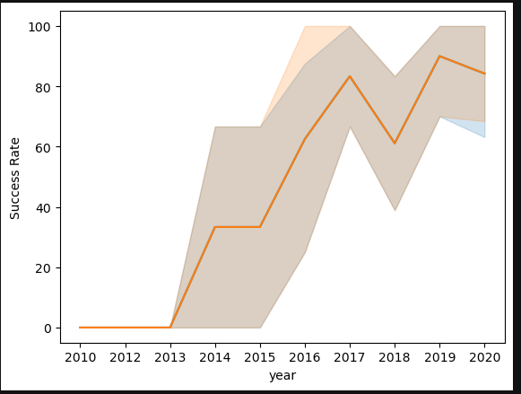
Launch Success Yearly Trend
Success rates have shown a general increasing trend since 2013, with a slight dip observed in 2018. Recent years, particularly from 2019 onwards, have maintained a success rate hovering around 80%

Slide 24
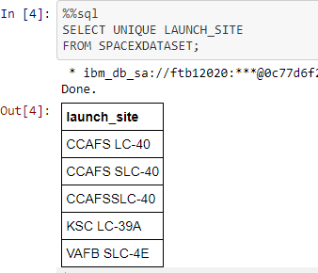
All Launch Site Names
Upon querying unique launch site names from the database, it was observed that 'CCAFS SLC-40' and 'CCAFSSLC-40' likely represent the same launch site, possibly due to data entry errors. The previous name, 'CCAFS LC-40,' was identified. As a result, there are likely only three unique launch site values: 'CCAFS SLC-40,' 'KSC LC-39A,' and 'VAFB SLC-4E.

Slide 25
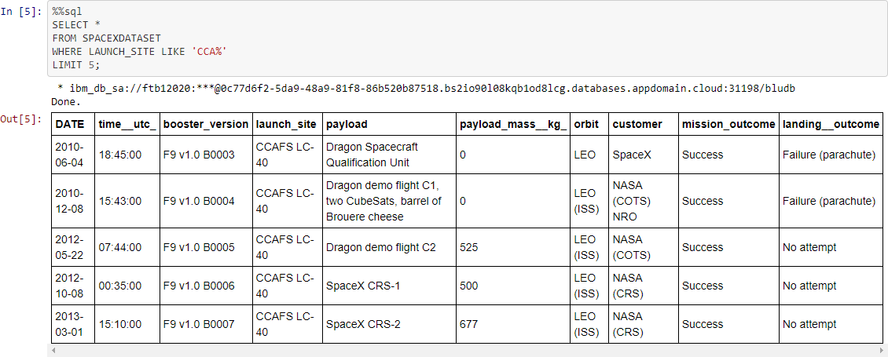
Launch Site Names Begin with 'CCA'
25

Slide 26
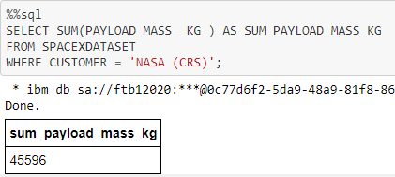
Total Payload Mass
This specific query sums the total payload mass in kilograms for missions where NASA was the customer. The presence of 'CRS' (Commercial Resupply Services) in the results suggests that these payloads were designated for the International Space Station (ISS).

Slide 27
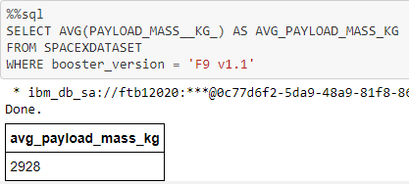
Average Payload Mass by F9 v1.1
This particular query calculates the average payload mass for launches that utilized the booster version 'F9 v1.1.' The results indicate that the average payload mass for launches with this specific booster version falls on the lower end of our observed payload mass range.

Slide 28
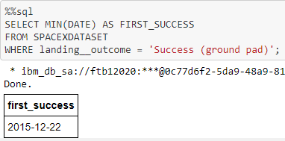
First Successful Ground Landing Date
This query returns the date of the first successful ground pad landing. It reveals that the initial successful ground pad landing didn't occur until the end of 2015. Successful landings, in general, began to appear in the data starting in 2014.

Slide 29
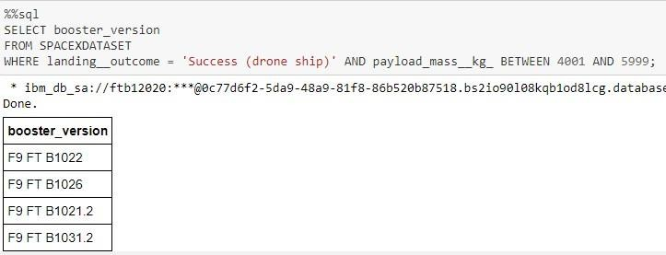
Successful Drone Ship Landing with Payload between 4000 and 6000
This query returns the four booster versions that had successful drone ship landings and a payload mass falling between 4000 and 6000, non-inclusively
29

Slide 30
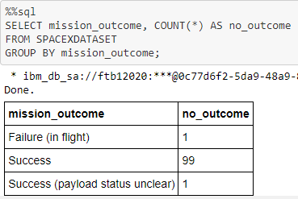
Total Number of Successful and Failure Mission Outcomes
This query returns a count of each mission outcome. SpaceX achieves its mission outcome nearly 99% of the time, indicating that most landing failures are intentional. Interestingly, one launch has an unclear payload status, and unfortunately, one failed in flight.

Slide 31
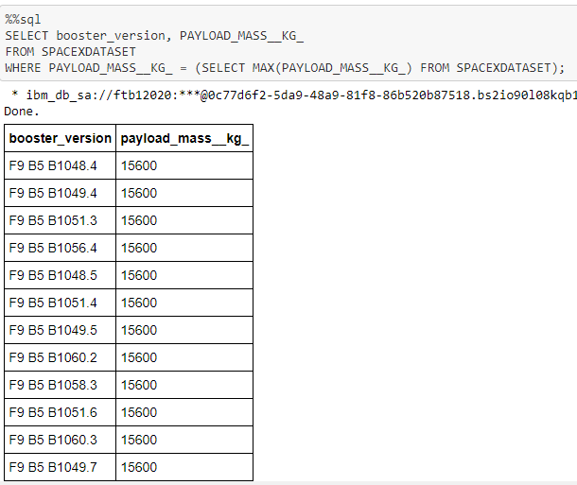
Boosters Carried Maximum Payload
This query returns the booster versions that carried the highest payload mass of 15600 kg. The booster versions identified are very similar, all belonging to the F9 B5 B10xx.x variety. This suggests a correlation between payload mass and the specific booster version used.

Slide 32
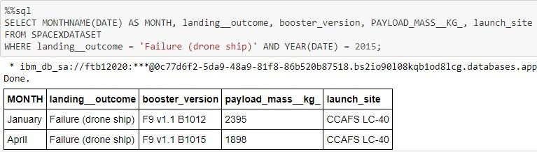
2015 Launch Records
This query retrieves data for launches in 2015, including information such as Month, Landing Outcome, Booster Version, Payload Mass (kg), and Launch site, specifically focusing on instances where stage 1 failed to land on a drone ship. The results indicate that there were two occurrences of such failures during that year.
32

Slide 33
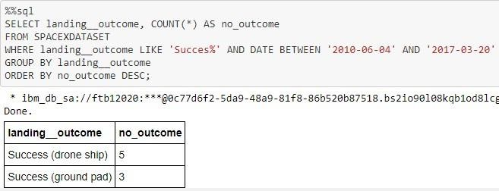
Rank Landing Outcomes Between 2010-06-04 and 2017-03-20
This query retrieves a list of successful landings between June 4, 2010, and March 20, 2017, inclusive. The successful landings are categorized into two types: drone ship and ground pad landings. The results show a total of 8 successful landings during this specified time period.

Slide 34

Section 3

Slide 35
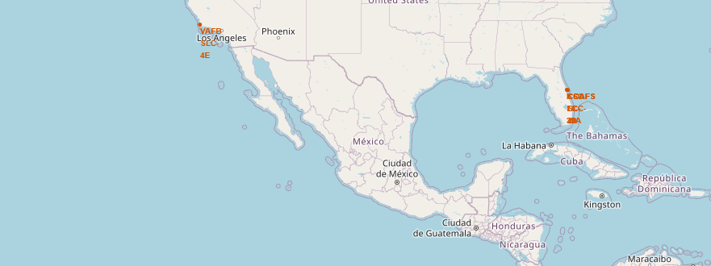
< Launch Site Locations >
The map shows all launch sites relative US map
all launch sites are situated near the ocean.

Slide 36
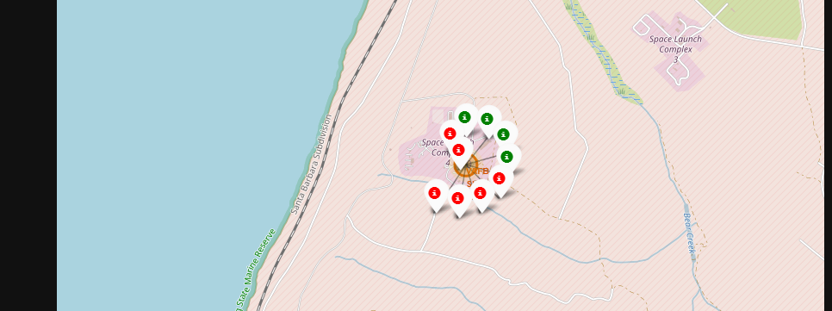
< Color-Coded Launch Markers >
On the Folium map, clusters are interactive and can be clicked on to reveal individual successful landings (green icon) and failed landings (red icon). As an example, VAFB SLC-4E cluster displays 4 successful landings and 6 failed landings

Slide 37
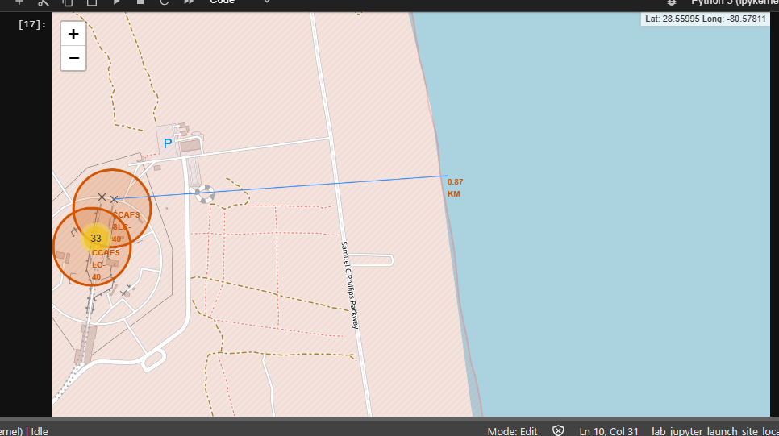
<Folium Map Screenshot 3>

Slide 38

Section 4

Slide 39
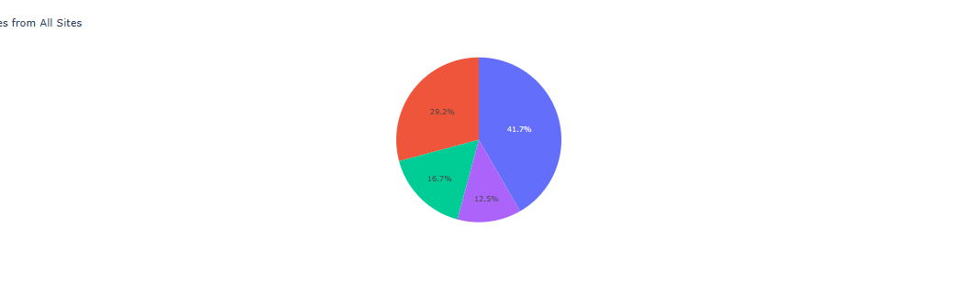
< Successful Launches Across Launch Sites >
This pie chart illustrates the distribution of successful landings across all launch sites. Notably, CCAFS LC-40 is the former name of CCAFS SLC-40, resulting in an equivalent number of successful landings for CCAFS and KSC. However, the majority of these successes occurred before the name change. In contrast, VAFB exhibits the smallest share of successful landings, possibly attributable to a smaller sample size and increased launch difficulty on the west coast.

Slide 40
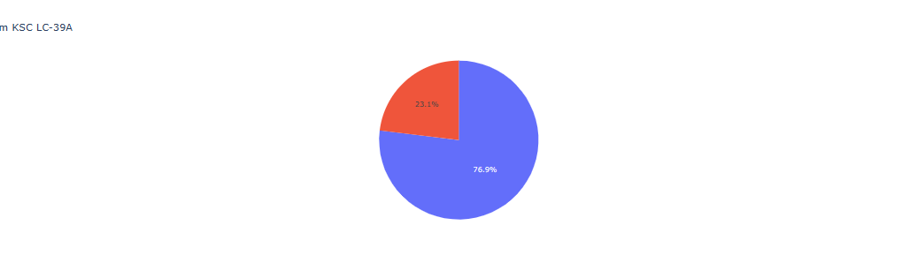
< Highest Success Rate Launch Site >
KSC LC-39A boasts the highest success rate among launch sites, with a total of 10 successful landings and 3 failed landings

Slide 41
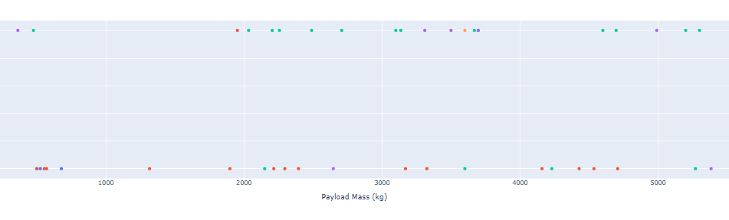
<Booster Version Category >
The Plotly dashboard includes a Payload range selector, but it is set from 0-10000 instead of the maximum Payload of 15600. The 'Class' indicates 1 for a successful landing and 0 for failure. The scatter plot also accounts for the booster version category in color and the number of launches in point size. In this particular range of 0-6000, there are two failed landings with payloads of zero kg, adding an interesting aspect to the data.

Slide 42

Section 5

Slide 43
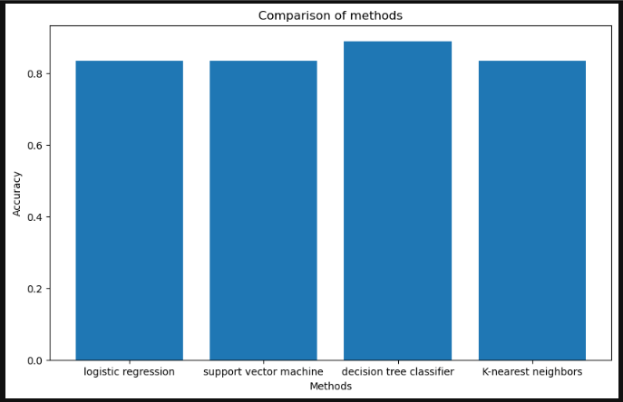
Classification Accuracy
All machine learning models produced similar results with virtually the same accuracy on the test set, achieving around 83.33%. However, it's important to note that the test size is small, with a sample size of only 18. This limited sample size can lead to large variance in accuracy results, as observed in the Decision Tree Classifier model in repeated runs. To obtain a more reliable determination of the best model, additional data is likely needed.

Slide 44
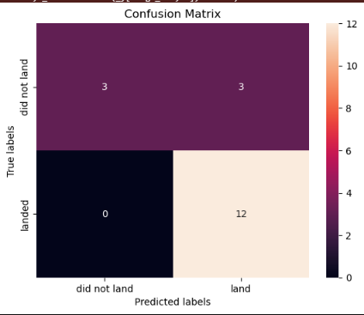
Confusion Matrix
As all models exhibited identical performance on the test set, the confusion matrix remains consistent across all models. The predictions indicate that the models correctly identified 12 successful landings when the true label was a successful landing. However, the models also incorrectly predicted 3 successful landings when the true label was an unsuccessful landing (false positives), contributing to an overall trend of over-predicting successful landings.

Slide 45
Conclusions
Our objective was to develop a machine learning model for Space Y, aiming to compete with SpaceX by predicting successful Stage 1 landings and potentially saving around $100 million USD per launch. We utilized data from a public SpaceX API and performed web scraping on the SpaceX Wikipedia page.
After creating data labels, we stored the information in an IBM DB2 SQL database. The visualization of the data was presented through a dashboard. The machine learning model achieved an accuracy of 83%, and Elon Musk of Space Y can leverage this model to predict successful Stage 1 landings before launch, aiding in strategic decision-making. However, for enhanced model determination and accuracy improvement, it is advisable to gather more data.

Slide 46
Appendix
https://github.com/OmarAdlii/Applied-Data-Science-Capstone.git

Slide 47


